Slide 1
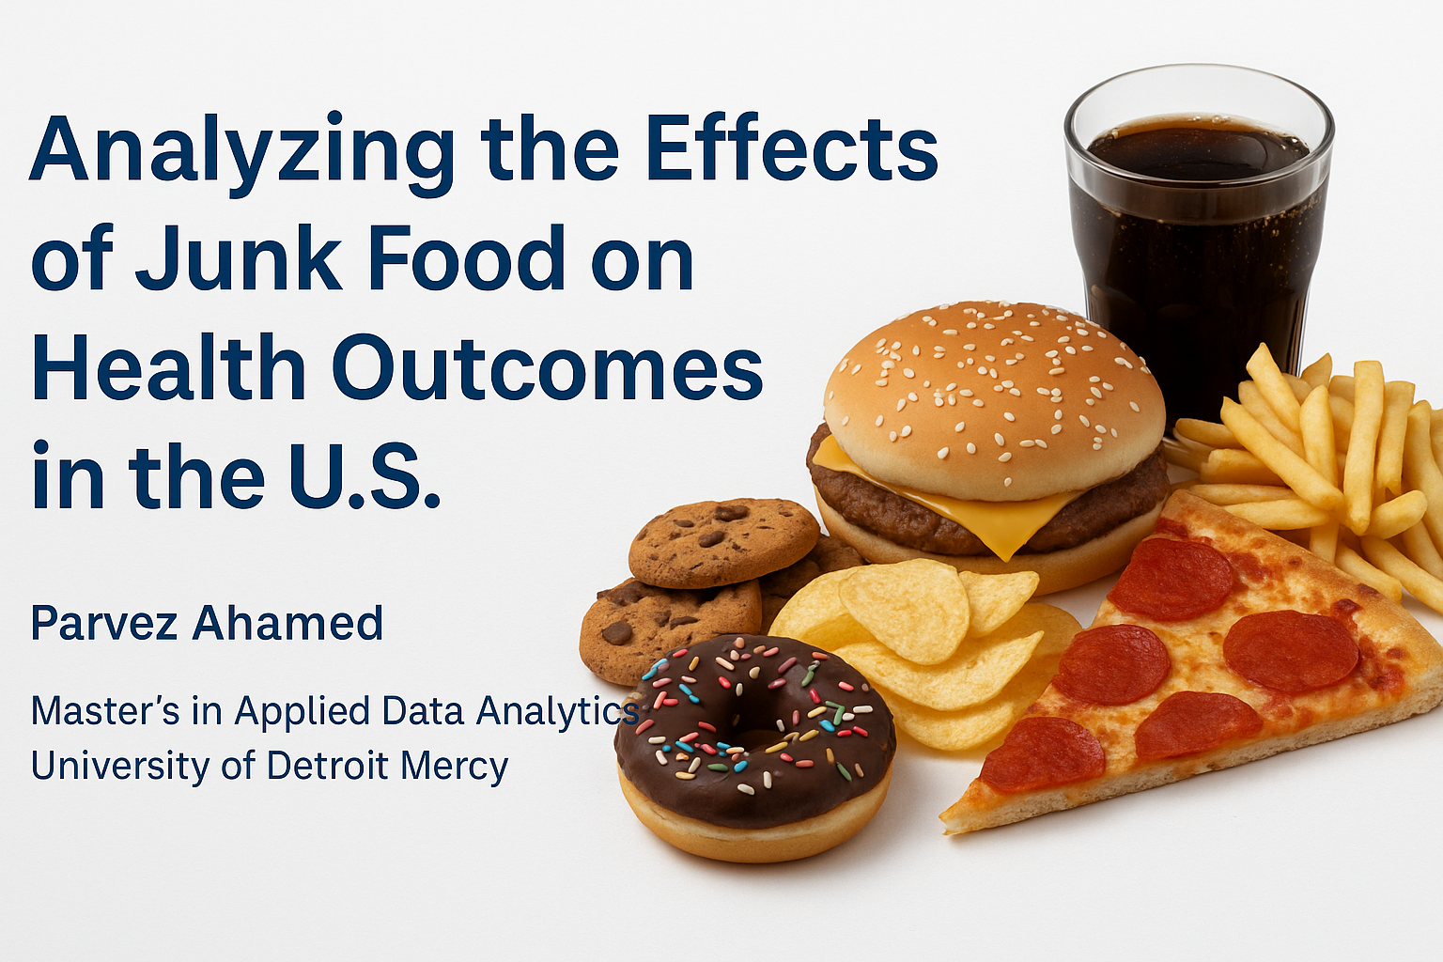
Analyzing the Effects of Junk Food on Health Outcomes in the U.S
Parvez Ahamed
Master’s in Applied Data Analytics
University of Detroit Mercy
Advisor: Dr. Yu Peng Lin

Slide 2

Research Objective
To study the impact of junk food consumption on obesity, diabetes, and cardiovascular health using dietary intake and health biomarkers in the U.S. population.

Slide 3
Introduction
In today's fast-paced world, junk food has become a dietary staple for many Americans due to its convenience, affordability, and taste.
These ultra-processed foods are typically high in added sugars, saturated fats, and sodium, yet low in nutritional value.
The rise in junk food consumption is closely tied to increasing rates of obesity, type 2 diabetes, and cardiovascular diseases in the U.S.
This study explores not just weight gain, but the metabolic consequences of junk food even among individuals who are not overweight.
By linking dietary behavior to clinical biomarkers using NHANES 2017–2018 data, we aim to uncover the hidden biological impacts of ultra-processed diets.

Slide 4
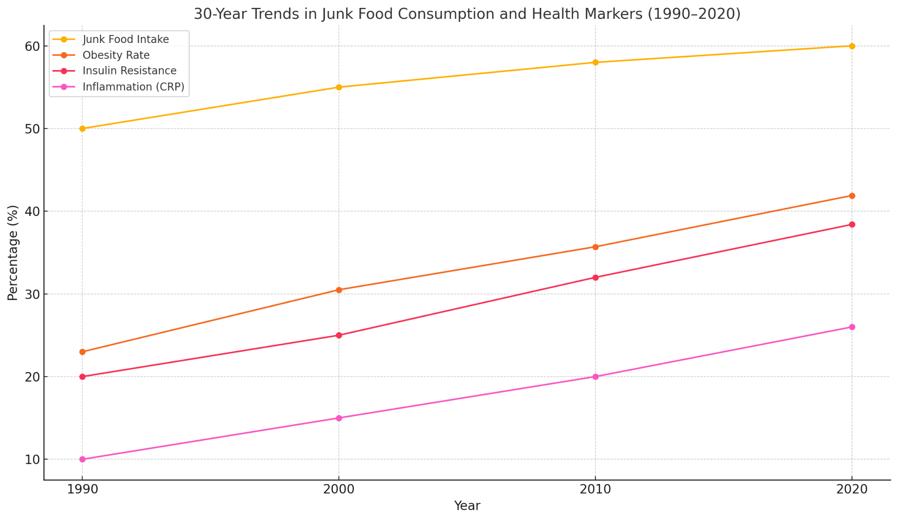
Why It Matters
Over 42% of U.S. adults are obese (CDC, 2022).
Junk food = ultra-processed, calorie-dense, low-nutrient.
Metabolic harm can occur even in lean individuals.
Shifts public health focus from calories → food quality.

Slide 5

Data Source
National Health and Nutrition Examination Survey
Combines
Dietary recall (24-hour food intake)
Lab biomarkers (insulin, HbA1c, cholesterol, CRP)
Demographics
Nationally representative sample

Slide 6

Methodology
Food descriptions scanned for keywords (e.g., “pizza,” “chips”)
Junk food calories aggregated → junk_kcal_pct
Merged with lab data
Ran OLS regressions and logistic regressions

Slide 7

Key Variables
junk_kcal_pct - Independent -% of daily calories from junk food
DR1TTFAT, DR1TSUGR, DR1TSODI, DR1TPROT, DR1TCARB - Control Variables - Nutrient adjustments
LBXIN, LBXGH, LBXTC, LBXHSCRP - Dependent - Biomarkers for metabolism, sugar, cholesterol, inflammation

Slide 8
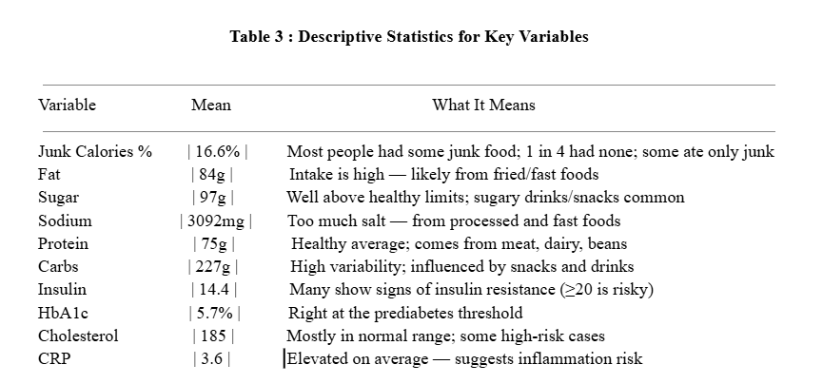

Descriptive Statistics

Slide 9


Regression Framework
Model 1: Insulin ~ Junk food % + Nutrients
Model 2: HbA1c ~ Junk food % + Nutrients
Model 3: Cholesterol ~ Junk food % + Nutrients
Model 4: CRP ~ Junk food % + Nutrients

Slide 10
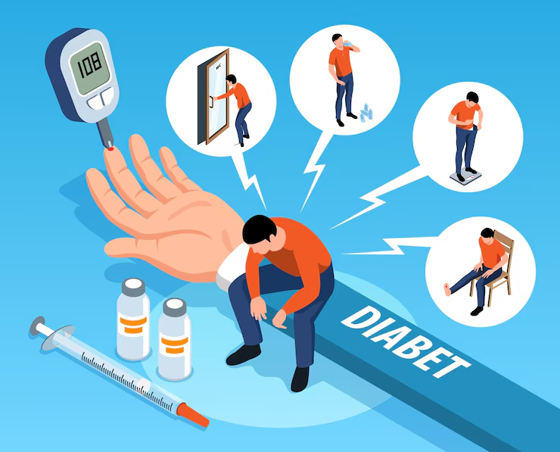
Model: Insulin (LBXIN)
Insulin = β₀ + β₁·junk_kcal_pct + β₂·fat + β₃·sugar + β₄·sodium + β₅·protein + β₆·carbs + ε
Key Finding Sodium is significantly associated with insulin (p = 0.0029)***. Junk food % is not statistically significant (p = 0.3061), but trend is positive.
Interpretation Higher sodium intake → increased fasting insulin, suggesting early insulin resistance even if junk food % alone isn’t significant.

Slide 11
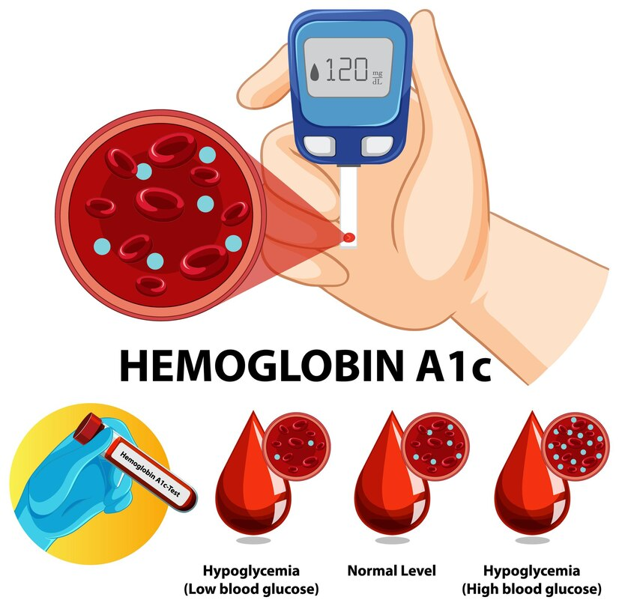
Model: HbA1c (LBXGH)
HbA1c = β₀ + β₁·junk_kcal_pct + β₂·fat + β₃·sugar + β₄·sodium + β₅·protein + β₆·carbs + ε
Key Findings Sodium is significant (p = 0.0121)** Protein is marginally significant (p = 0.0460)** Junk food % is not significant (p = 0.3311)
Interpretation Sodium intake raises long-term glucose levels (HbA1c), while higher protein slightly lowers it ,independent of junk food %.

Slide 12

Model: Cholesterol (LBXTC)
Cholesterol = β₀ + β₁·junk_kcal_pct + β₂·fat + β₃·sugar + β₄·sodium + β₅·protein + β₆·carbs + ε
Key Findings No predictors (including junk food %) are statistically significant All p-values > 0.20
Interpretation No strong relationship found between junk food or nutrient intake and cholesterol in this model.

Slide 13
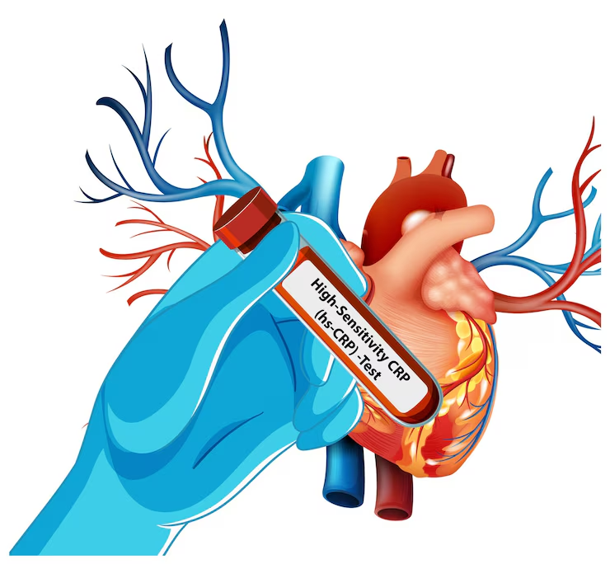
Model: CRP (LBXHSCRP)
CRP = β₀ + β₁·junk_kcal_pct + β₂·fat + β₃·sugar + β₄·sodium + β₅·protein + β₆·carbs + ε
Key Findings Sugar (p = 0.0096)***, Sodium (p = 0.0042)***, and Carbs (p = 0.0033)*** are significant Junk food % is not significant (p = 0.6594)
Interpretation CRP (inflammation) increases with higher sugar and sodium, while higher carb intake (likely complex carbs/fiber) is protective.

Slide 14
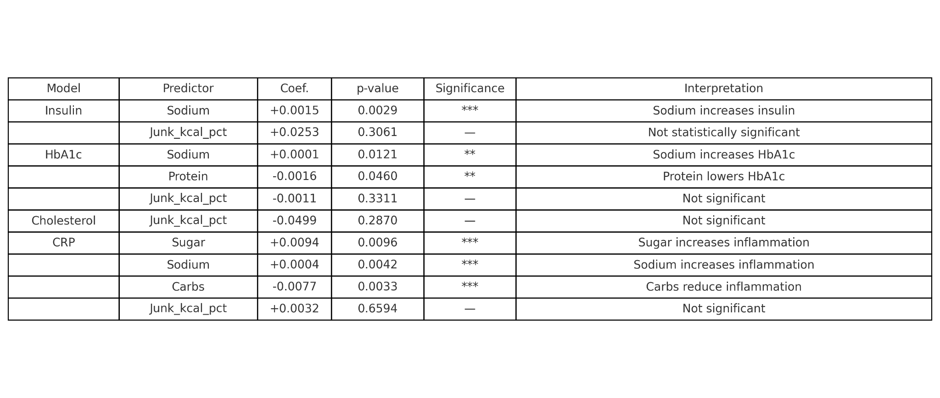
OLS Regression Summary with Significance Levels

Slide 15
Key Findings
Fasting Insulin Sodium intake is significantly associated with higher insulin (p < 0.01) → early sign of insulin resistance. Junk food % shows a positive trend but not statistically significant.
HbA1c (Blood Sugar Control) Sodium increases HbA1c (p < 0.05). Protein has a small but significant protective effect (p < 0.05). Junk food % is not a significant predictor.
Total Cholesterol No dietary factors, including junk food %, were significantly associated.
CRP (Inflammation) Sugar and sodium significantly increase inflammation (p < 0.01). Carbohydrates (likely fiber-rich) significantly reduce CRP (p < 0.01). Junk food % not significant.

Slide 16

Conclusion
Junk food consumption, especially high in sugar and sodium, contributes to early metabolic dysfunction even in normal-weight individuals.
Fasting insulin is the most sensitive marker affected by junk food composition.
Sugar and sodium are consistent risk drivers across insulin, HbA1c, and CRP.
Protein and complex carbs show protective effects, especially against inflammation.
It's not just how much we eat it's what we eat.

Slide 17

Q&A Slide

Slide 18
THANK YOU

